Slide 1
DATA 300
Time Series

Slide 2
Training set versus holdout set
Training set: part of the dataset used to train the model, i.e., calculate model parameters. Usually should be 80% of the dataset.

Slide 3
Training set versus holdout set
Training set: part of the dataset used to train the model, i.e., calculate model parameters. Usually should be 80% of the dataset.
Holdout set: the rest of the dataset that were NOT in the training process. Use it to test the model.

Slide 4
Training set versus holdout set
Training set: part of the dataset used to train the model, i.e., calculate model parameters. Usually should be 80% of the dataset.
Holdout set: the rest of the dataset that were NOT in the training process. Use it to test the model.
The common practice is to randomly select 80% of the dataset as training set, and use the rest as holdout test set.
This randomness is important – think about bias-variance trade-off, where low variance is defined as “small change in the model when training set changes”.
In other words, we want a robust model that does not change much when we select different portions of the training set.

Slide 5
Brainstorming
What does it mean to have a small error on the training set, but a high error on the test set?

Slide 6
Brainstorming
What does it mean to have a small error on the training set, but a high error on the test set?
The model worked too hard to minimize the bias and resulted in high variance, i.e., performance change drastically with small changes in sample units.
Common solutions: use a less complex model, remove variables (let the model have less information on training set).

Slide 7
What is the difference between two following two datasets?
To predict for stock price in September, we have collected the following two datasets..
Stock | Market cap | Revenue | Head-quarter | Year founded
Apple | $2.5 trillion | $82.96B | CA | 1976
Amazon | $1.3 trillion | $469.8B | WA | 1994
…
Stock | Price on 08/17 | 08/18 | 08/19 | 08/22
Apple | $174.55 | $174.15 | $171.52 | $167.57
Amazon | $142.10 | $142.30 | $138.23 | $133.22
…

Slide 8
What is the difference between two following two datasets?
To predict for stock price in September, we have collected the following two datasets..
The left one: different characteristics of the sample unit recorded at a given point in time.
The right one: One characteristic (stock price) recorded at different points in time.
Stock | Market cap | Revenue | Head-quarter | Year founded
Apple | $2.5 trillion | $82.96B | CA | 1976
Amazon | $1.3 trillion | $469.8B | WA | 1994
…
Stock | Price on 08/17 | 08/18 | 08/19 | 08/22
Apple | $174.55 | $174.15 | $171.52 | $167.57
Amazon | $142.10 | $142.30 | $138.23 | $133.22
…

Slide 9
Definition
A cross-sectional dataset is a dataset that has N sample units and P variables reflecting on P different aspects of the sample units.
A time series dataset is a dataset with N sample units with only ONE variable, but this variable is recorded on T different time stamps.
A panel dataset is a dataset with N sample units and P variables, each variable is further recorded on T different time stamps.

Slide 10
Definition
A cross-sectional dataset is a dataset that has N sample units and P variables reflecting on P different aspects of the sample units.
Most models are designed to handle this type of dataset.
A time series dataset is a dataset with N sample units with only ONE variable, but this variable is recorded on T different time stamps.
Calls for time series models.
A panel dataset is a dataset with N sample units and P variables, each variable is further recorded on T different time stamps.
Needs very specialized complex models.

Slide 11
Recall that..
Training set: part of the dataset used to train the model, i.e., calculate model parameters. Usually should be 80% of the dataset.
Holdout set: the rest of the dataset that were NOT in the training process. Use it to test the model.
The common practice is to randomly select 80% of the dataset as training set, and use the rest as holdout test set.
This randomness is important – think about bias-variance trade-off, where low variance is defined as “small change in the model when training set changes”.
In other words, we want a robust model that does not change much when we select different portions of the training set.

Slide 12
Recall that..
How to select training set and test set when the dataset is a time series?

Slide 13
Recall that..
How to select training set and test set when the dataset is a time series?
If using random sampling, you might end with the following dataset:
Training: housing price in Jan, Feb, April
Holdout: housing price in March
In other words, random sampling might result in using “future” information to predict for current information.

Slide 14
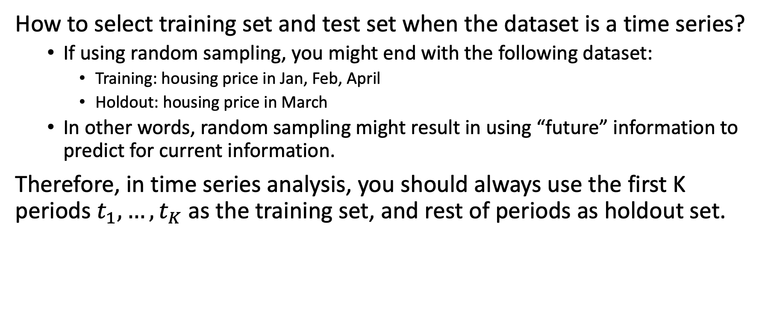
Recall that..
How to select training set and test set when the dataset is a time series?
If using random sampling, you might end with the following dataset:
Training: housing price in Jan, Feb, April
Holdout: housing price in March
In other words, random sampling might result in using “future” information to predict for current information.
Therefore, in time series analysis, you should always use the first K periods $t_{1},…,t_{K}$as the training set, and rest of periods as holdout set.

Slide 15
Now, knowing the housing data is a time series data..
Think of a way to use linear regression to predict housing price.

Slide 16
Now, knowing the housing data is a time series data..
Think of a way to use linear regression to predict housing price.
Linear trend?
Seasonal effect?

Slide 17

Now, knowing the housing data is a time series data..
Think of a way to use linear regression to predict housing price.
Linear trend?
$$price= β_{1}t+ ∈$$
How to interpret $β_{1}$?
Seasonal effect?

Slide 18
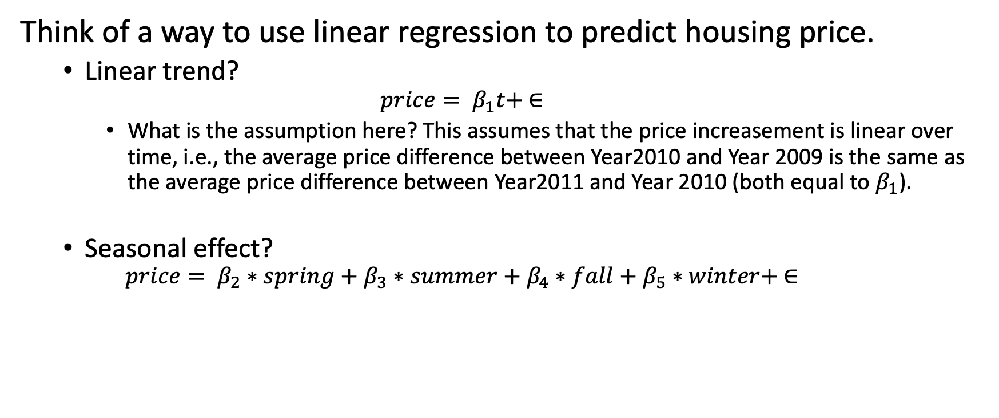
Now, knowing the housing data is a time series data..
Think of a way to use linear regression to predict housing price.
Linear trend?
$$price= β_{1}t+ ∈$$
What is the assumption here? This assumes that the price increasement is linear over time, i.e., the average price difference between Year2010 and Year 2009 is the same as the average price difference between Year2011 and Year 2010 (both equal to $β_{1}$).
Seasonal effect?
$$price= β_{2}∗spring+β_{3}∗summer+β_{4}∗fall+β_{5}∗winter+ ∈$$

Slide 19
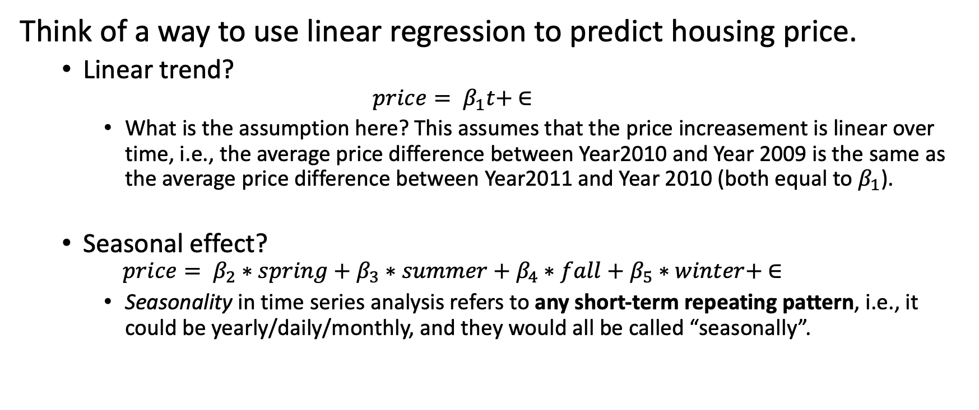
Now, knowing the housing data is a time series data..
Think of a way to use linear regression to predict housing price.
Linear trend?
$$price= β_{1}t+ ∈$$
What is the assumption here? This assumes that the price increasement is linear over time, i.e., the average price difference between Year2010 and Year 2009 is the same as the average price difference between Year2011 and Year 2010 (both equal to $β_{1}$).
Seasonal effect?
$$price= β_{2}∗spring+β_{3}∗summer+β_{4}∗fall+β_{5}∗winter+ ∈$$
Seasonality in time series analysis refers to any short-term repeating pattern, i.e., it could be yearly/daily/monthly, and they would all be called “seasonally”.

Slide 20
Use your imagination..
You are going to bring cake for your teammates and need to decide how many cakes to bring.. Thinking about the previous times when you brought cake:
What are the variables you could use to determine how many cakes to bring? You could create variables.
Time | # of cakes brought | # of cakes consumed
1 | 5 | 4
2 | 5 | 5
3 | 6 | 6
4 | 6 | 4
5 | 4 | 4
6 | 5 | 4
Current

Slide 21
Use your imagination..
You are going to bring cake for your teammates and need to decide how many cakes to bring.. Thinking about the previous times when you brought cake:
What are the variables you could use to determine how many cakes to bring? You could create variables.
Time | # of cakes brought | # of cakes consumed
1 | 5 | 4
2 | 5 | 5
3 | 6 | 6
4 | 6 | 4
5 | 4 | 4
6 | 5 | 4
Current
1) Based on how many cakes were consumed in previous time periods.
2) Based on the difference between # of cakes brought and # of cakes consumed in previous time periods.

Slide 22
Use your imagination..
You are going to bring cake for your teammates and need to decide how many cakes to bring.. Thinking about the previous times when you brought cake:
What are the variables you could use to determine how many cakes to bring? You could create variables.
Time | # of cakes brought | # of cakes consumed
1 | 5 | 4
2 | 5 | 5
3 | 6 | 6
4 | 6 | 4
5 | 4 | 4
6 | 5 | 4
Current
Based on how many cakes were consumed in previous time periods.
an Autoregressive process (AR)
2) Based on the difference between # of cakes brought and # of cakes consumed in previous time periods.
an moving average process (MA)

Slide 23
Basic time series models
AR models
MA models
ARMA models
ARIMA models

